Slide 1
Mathematics Department
Class of 2023

Slide 2
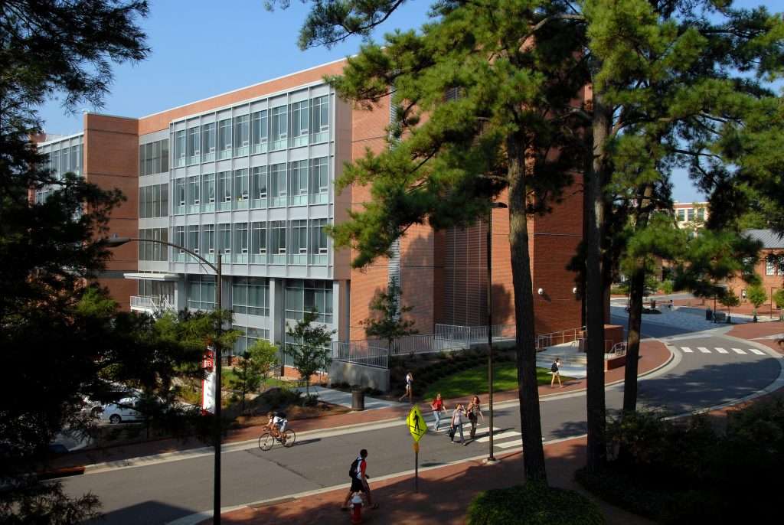
Congratulations Class of 2023

Slide 3
Undergraduate Degrees

Slide 4
Bachelor of Science in Applied Mathematics
Dawson Boone
Cum Laude

Slide 5
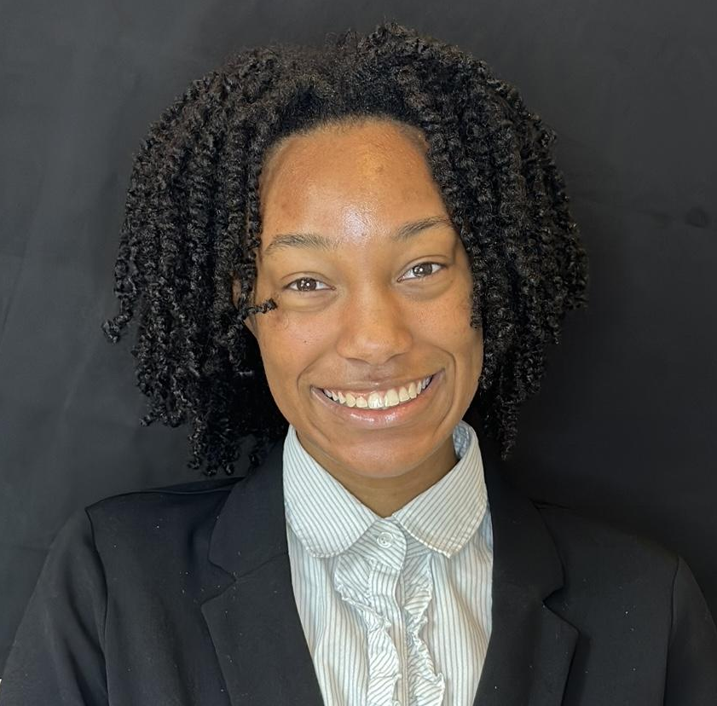
Bachelor of Science in Applied Mathematics
Omry Unique Brewster
Cum Laude

Slide 6
Bachelor of Science in Applied Mathematics
Lida Chen
Magna Cum Laude

Slide 7
Bachelor of Science in Applied Mathematics
Sanjay Devarajan
Magna Cum Laude

Slide 8
Bachelor of Science in Applied Mathematics
Yosi Esquivel Alcantara
Cum Laude

Slide 9
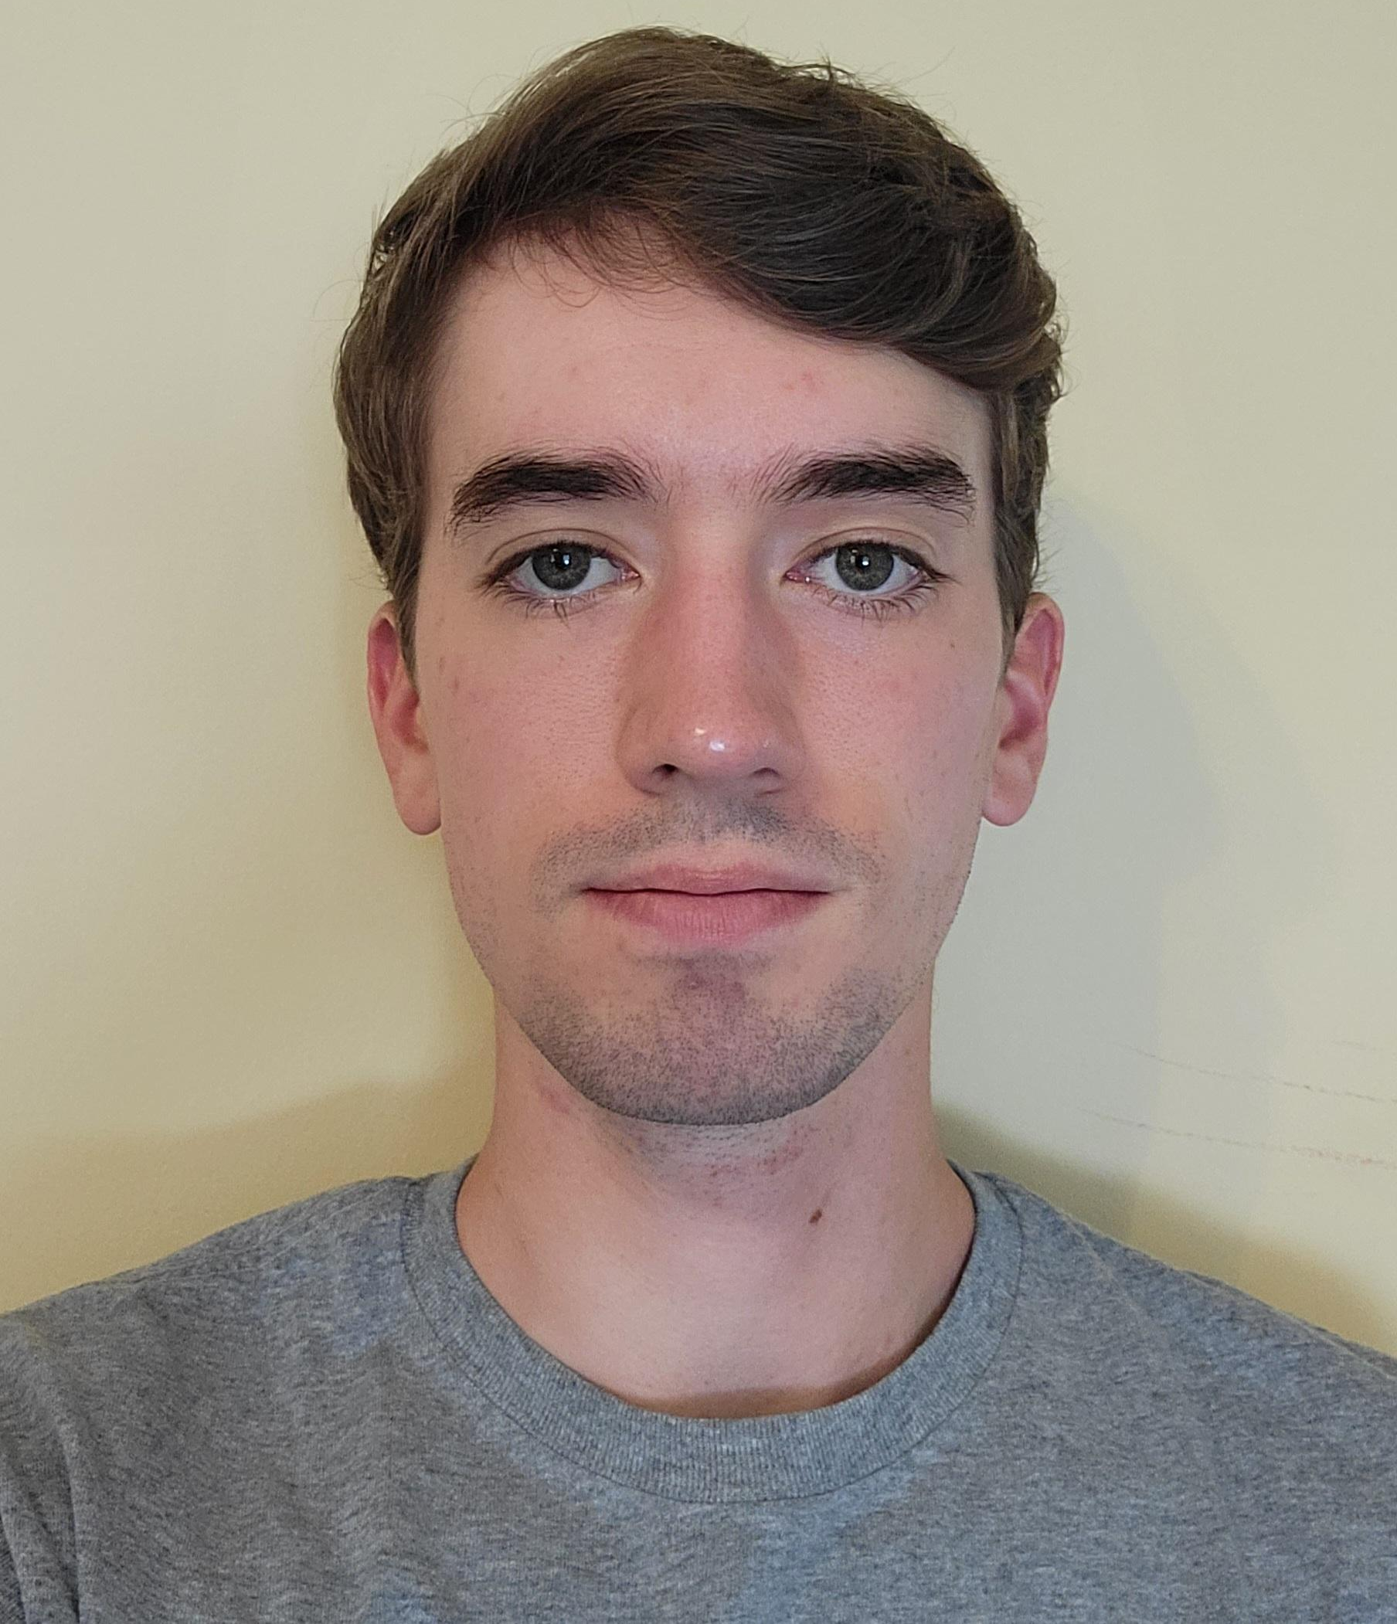
Bachelor of Science in Applied Mathematics
Daniel Ferriter
Summa Cum Laude

Slide 10
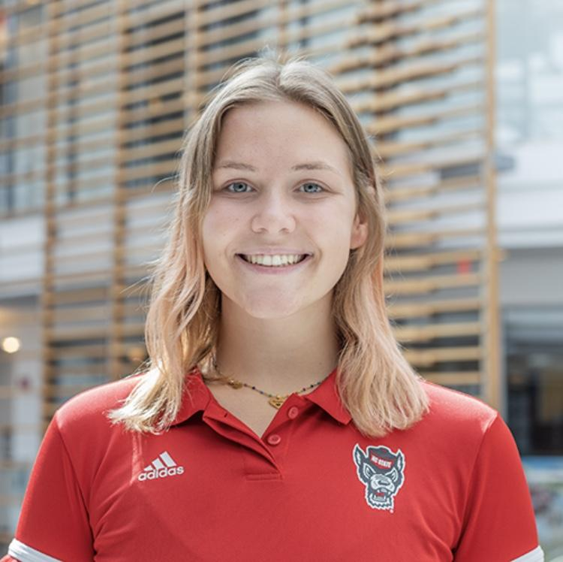
Bachelor of Science in Applied Mathematics
Caroline Heater

Slide 11
Bachelor of Science in Applied Mathematics
Jackson Holland
Magna Cum Laude

Slide 12
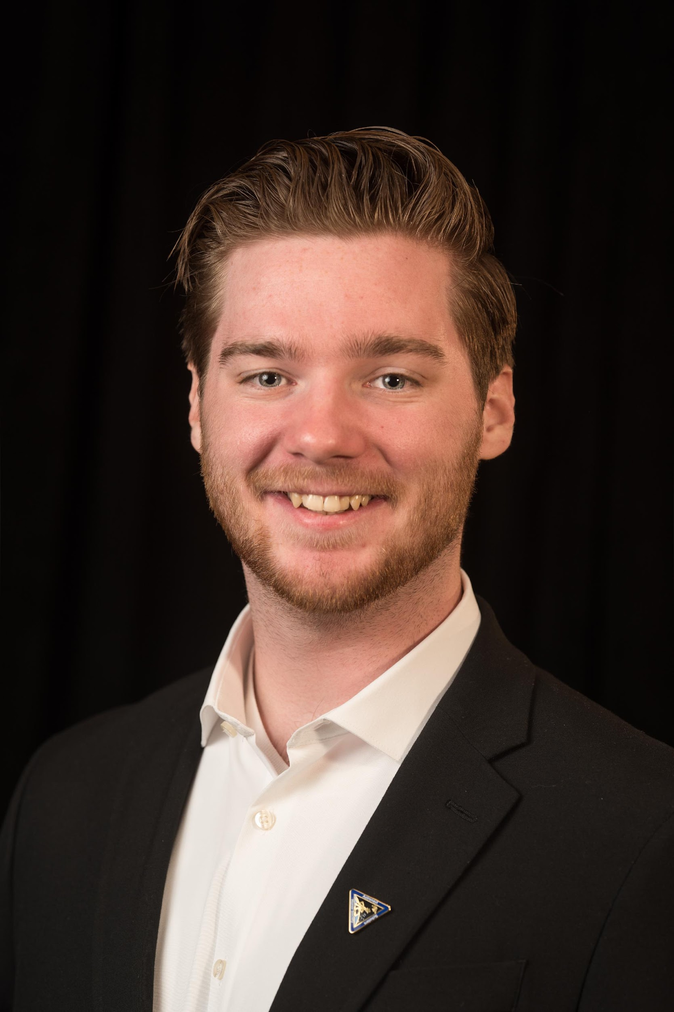
Bachelor of Science in Applied Mathematics
Caleb Witte Keaveney
Summa Cum Laude

Slide 13
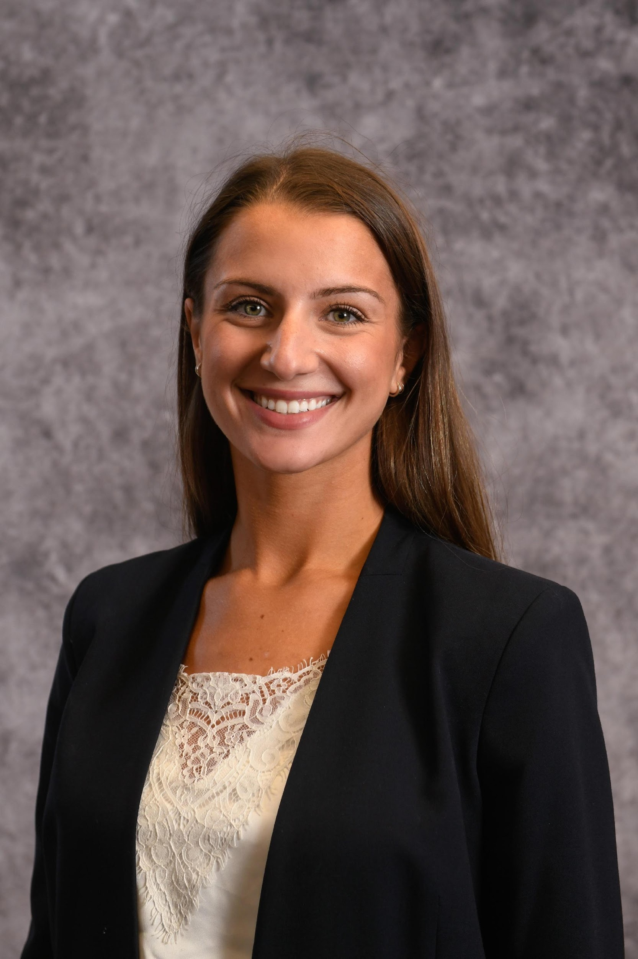
Bachelor of Science in Applied Mathematics
Annamarie Leske
Summa Cum Laude

Slide 14
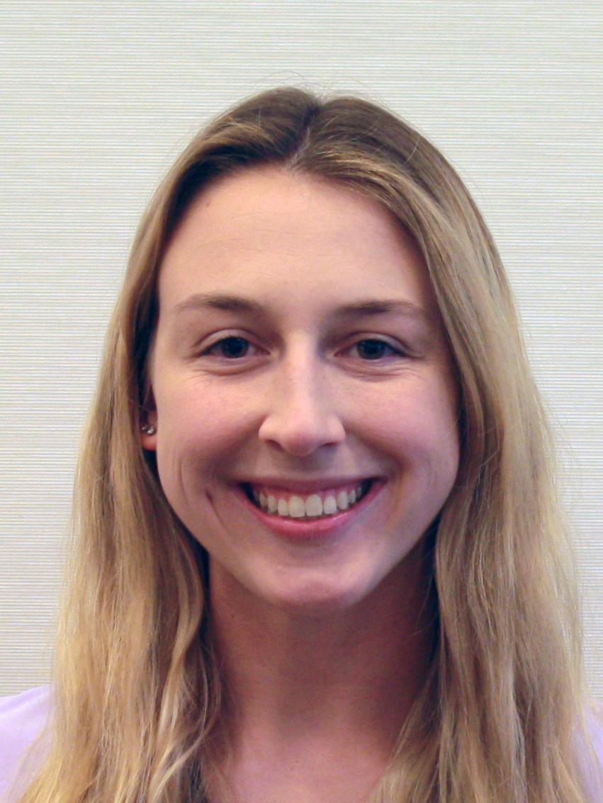
Bachelor of Science in Applied Mathematics
Jamie Loring
Summa Cum Laude

Slide 15
Bachelor of Science in Applied Mathematics
Gabe Milburn
Summa Cum Laude

Slide 16
Bachelor of Science in Applied Mathematics
Matthew Miller
Magna Cum Laude

Slide 17
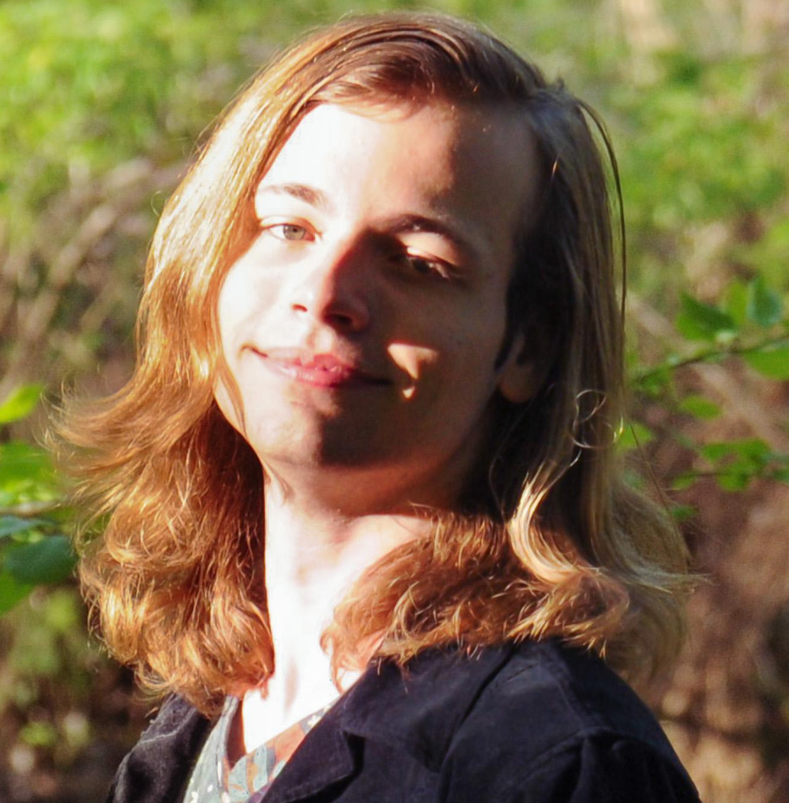
Bachelor of Science in Applied Mathematics
Niall Patrick Moncrief Mullane
Magna Cum Laude

Slide 18
Bachelor of Science in Applied Mathematics
Emi Planchon
Summa Cum Laude

Slide 19
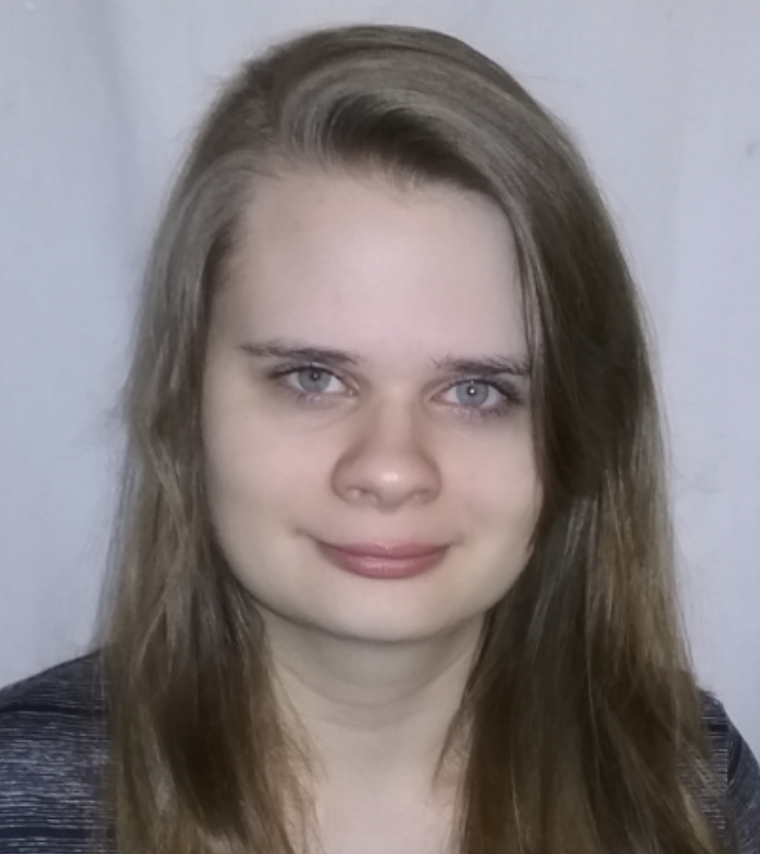
Bachelor of Science in Applied Mathematics
Helen Elizabeth Reed
Summa Cum Laude

Slide 20
Bachelor of Science in Applied Mathematics
Jarod Ryan Schneider
Summa Cum Laude

Slide 21
Bachelor of Science in Applied Mathematics
Austin Simpson

Slide 22
Bachelor of Science in Applied Mathematics
Qiuyi Wang
Magna Cum Laude

Slide 23
Bachelor of Science in Applied Mathematics
Chenrui Xie

Slide 24
Bachelor of Science in Applied Mathematics
Shengbo Yang

Slide 25
Bachelor of Science in Applied Mathematics
Brandon Young

Slide 26
Bachelor of Science in Mathematics
Amina Becirovic
Magna Cum Laude

Slide 27
Bachelor of Science in Mathematics
Shreyas Bellary
Magna Cum Laude

Slide 28
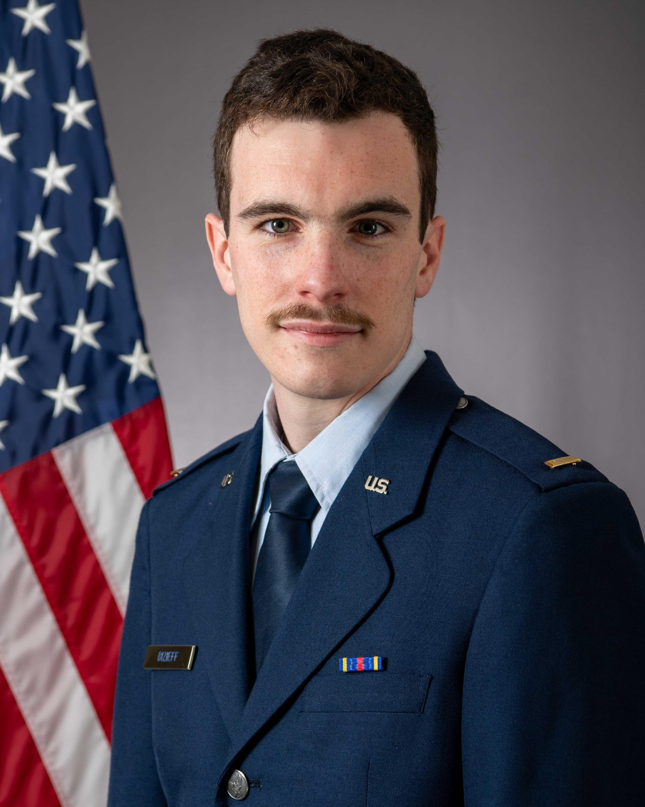
Bachelor of Science in Mathematics
Samuel Bizieff

Slide 29
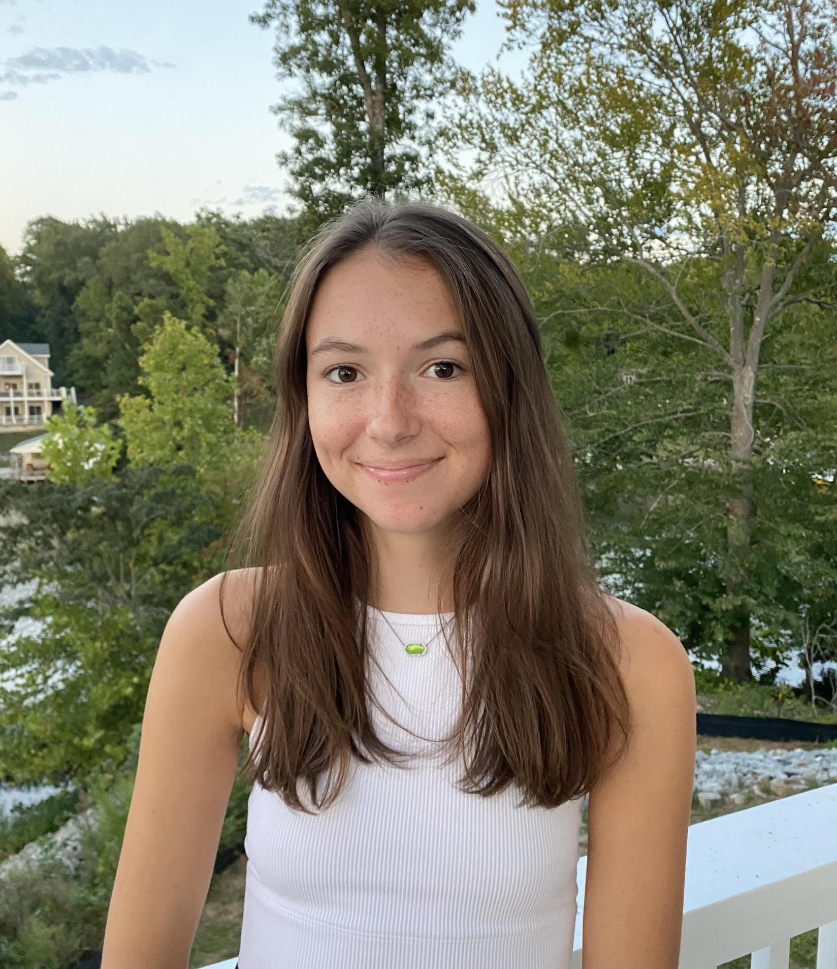
Bachelor of Science in Mathematics
Lilah Board
Summa Cum Laude

Slide 30
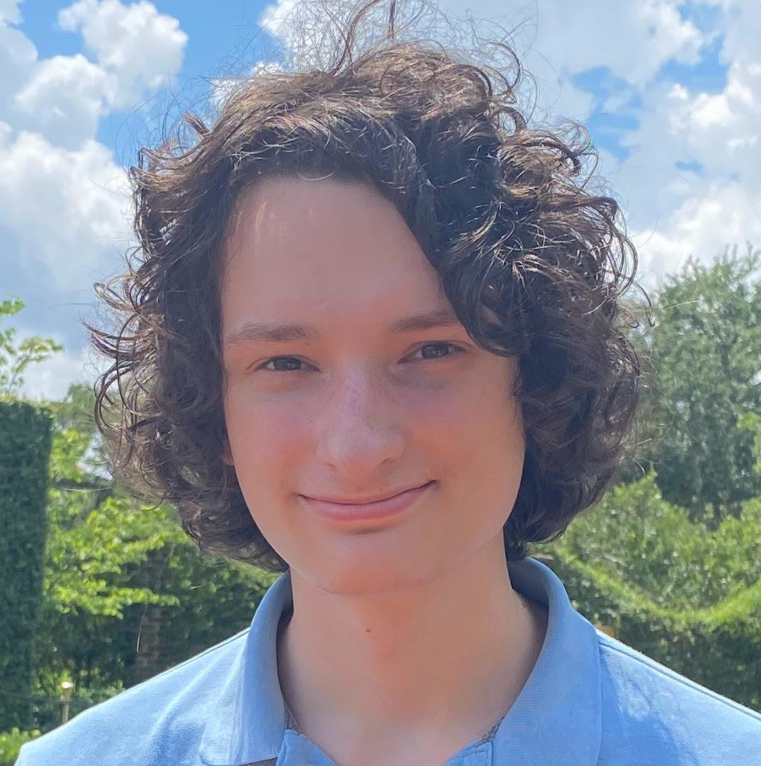
Bachelor of Science in Mathematics
Erick Matthew Boniface
Summa Cum Laude

Slide 31
Bachelor of Science in Mathematics
Shannon Carney
Summa Cum Laude

Slide 32
Bachelor of Science in Mathematics
Ben Clark
Summa Cum Laude

Slide 33
Bachelor of Science in Mathematics
Sera Cole

Slide 34
Bachelor of Science in Mathematics
Erica Council
Summa Cum Laude

Slide 35
Bachelor of Science in Mathematics
Srinivas Ganesan
Summa Cum Laude

Slide 36
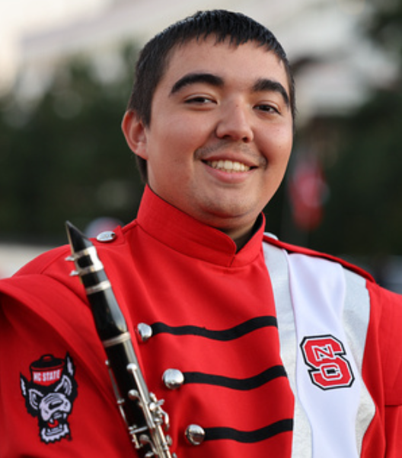
Bachelor of Science in Mathematics
Connell Gray
Cum Laude

Slide 37
Bachelor of Science in Mathematics
Savanna Gush
Cum Laude

Slide 38
Bachelor of Science in Mathematics
Pragya Haravu

Slide 39
Bachelor of Science in Mathematics
Jordan Jackson
Summa Cum Laude

Slide 40
Bachelor of Science in Mathematics
Xintong Jiang
Magna Cum Laude

Slide 41
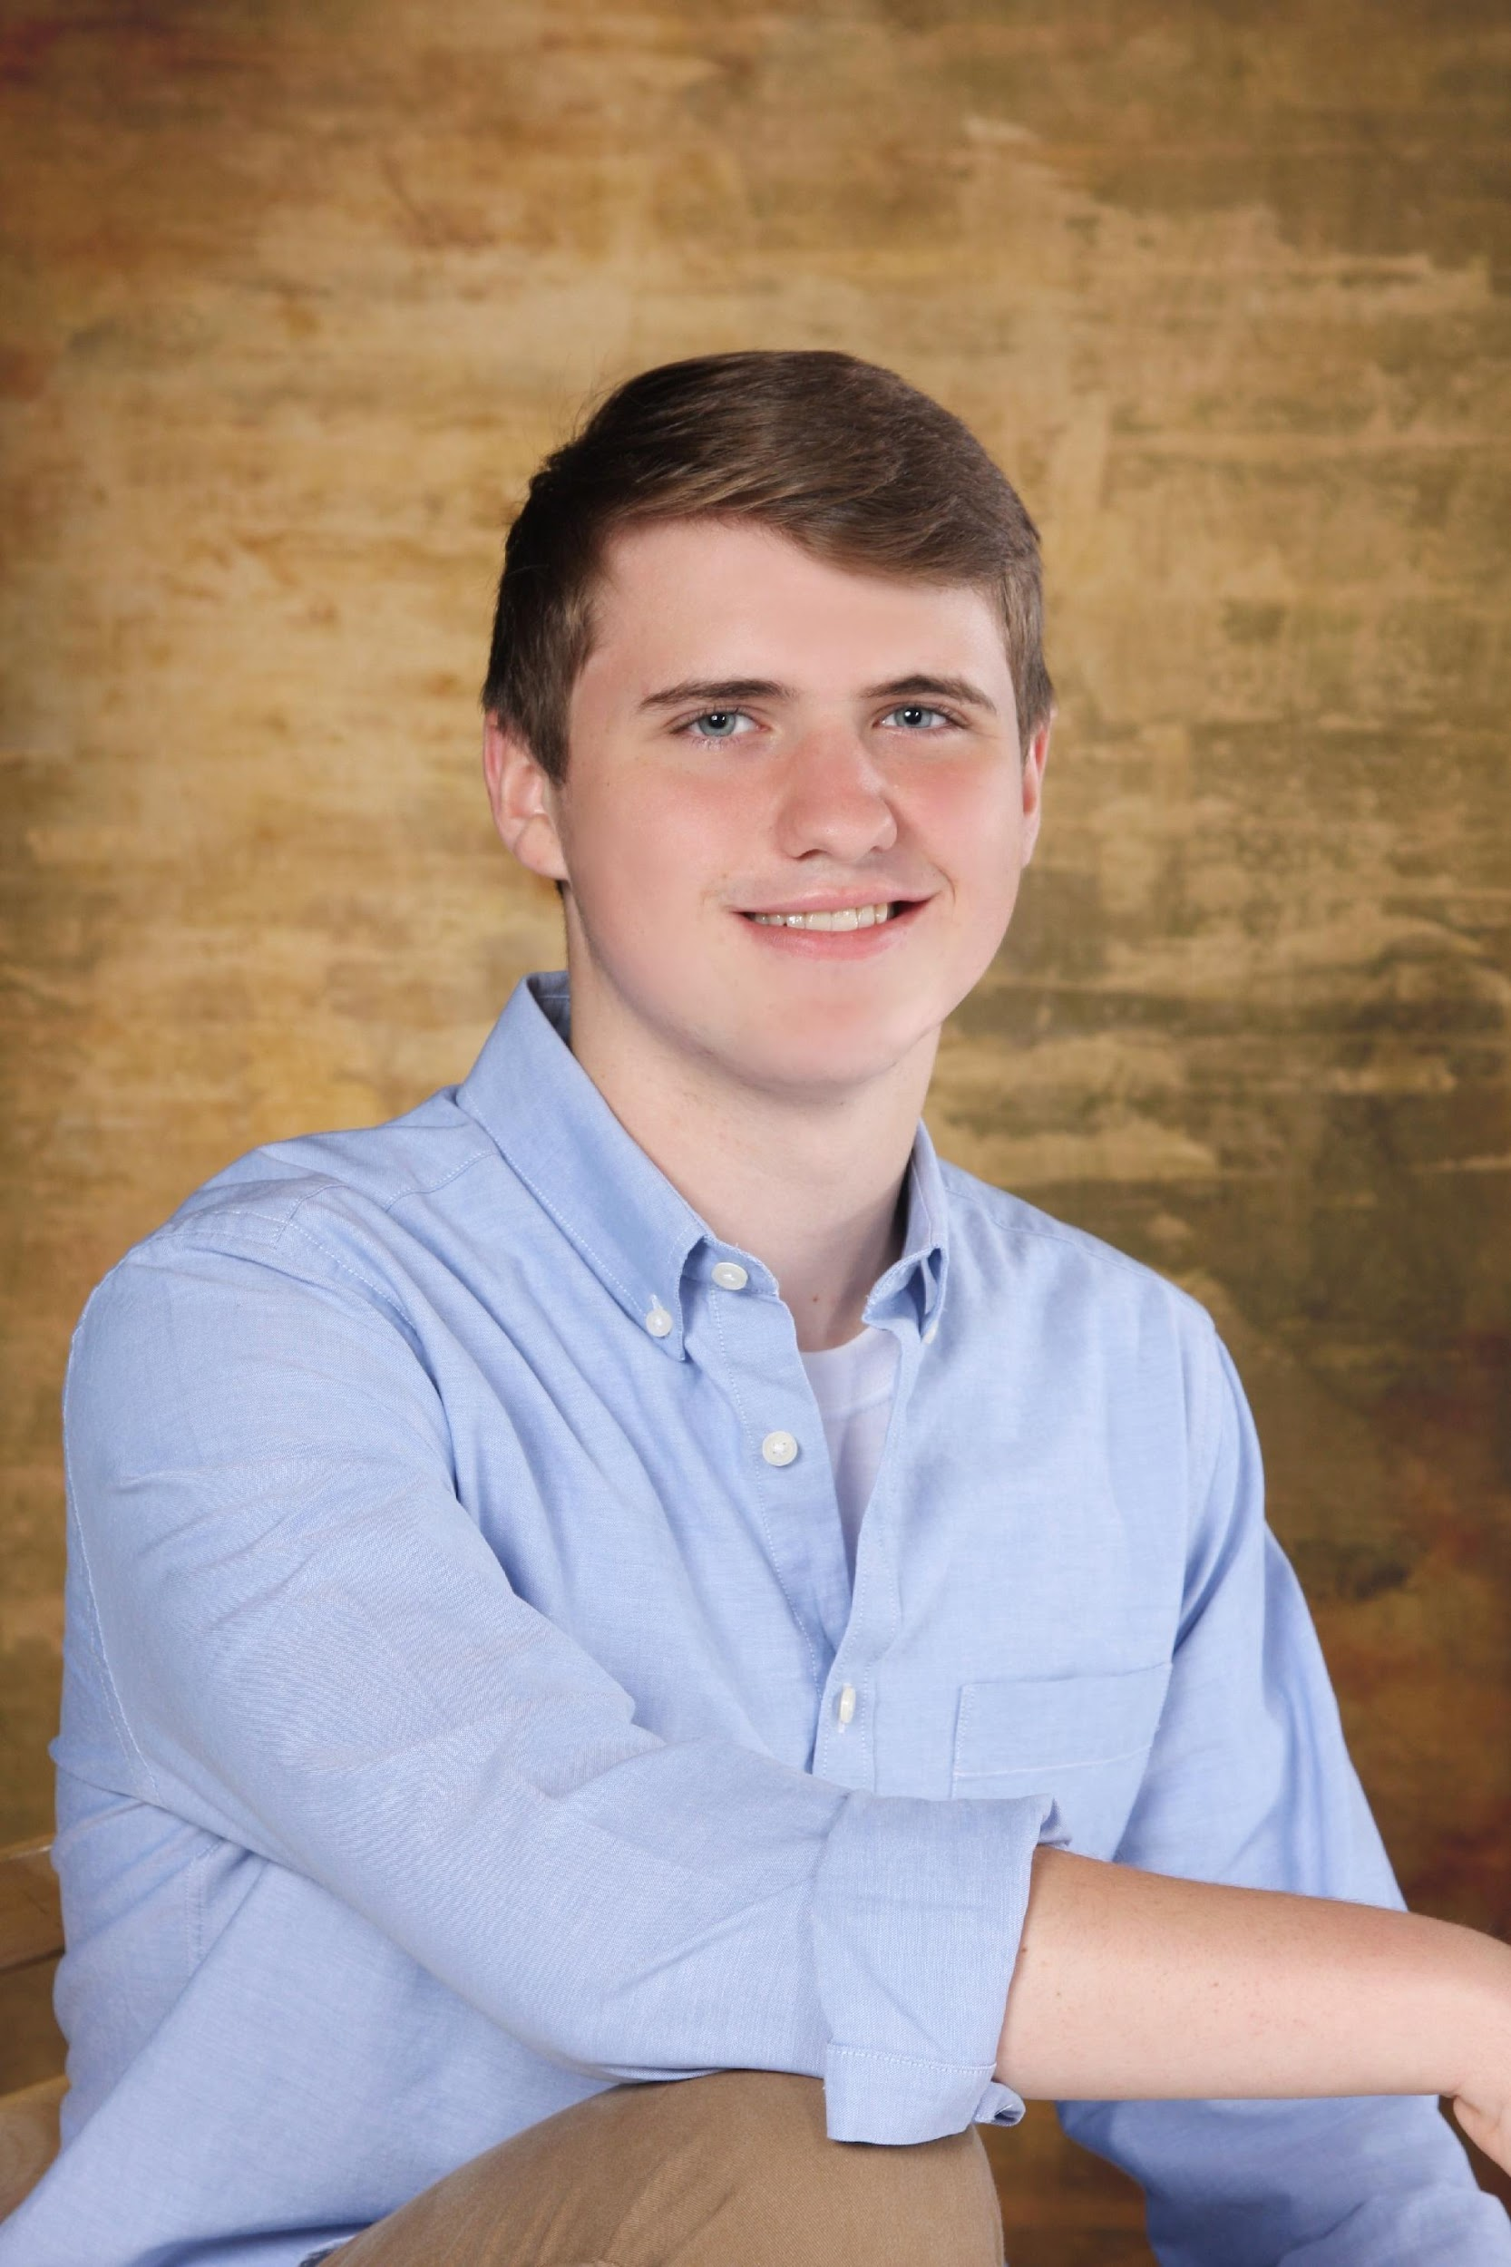
Bachelor of Science in Mathematics
Ryan Jones
Summa Cum Laude

Slide 42
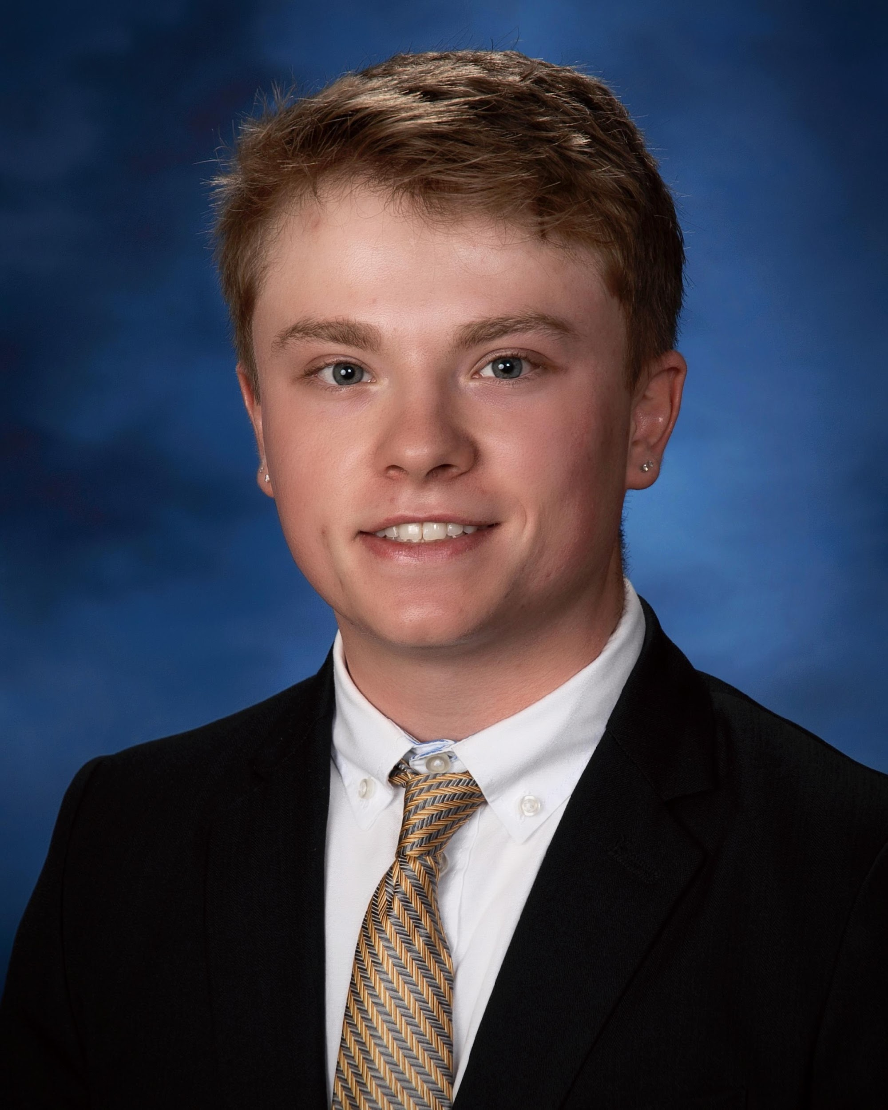
Bachelor of Science in Mathematics
George Katsoulis

Slide 43
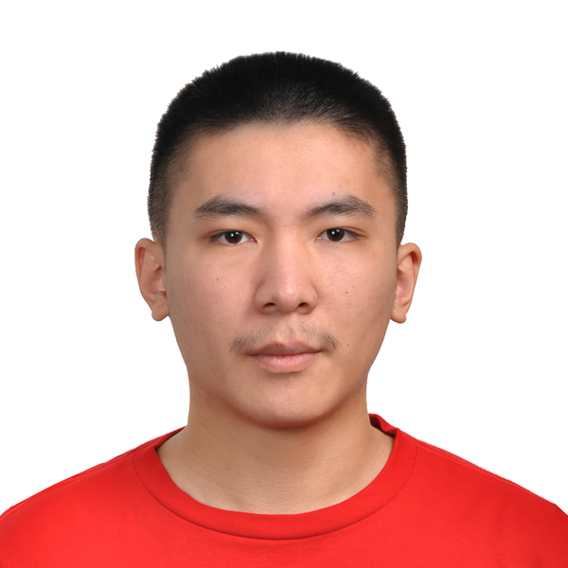
Bachelor of Science in Mathematics
Robin Li
Cum Laude

Slide 44
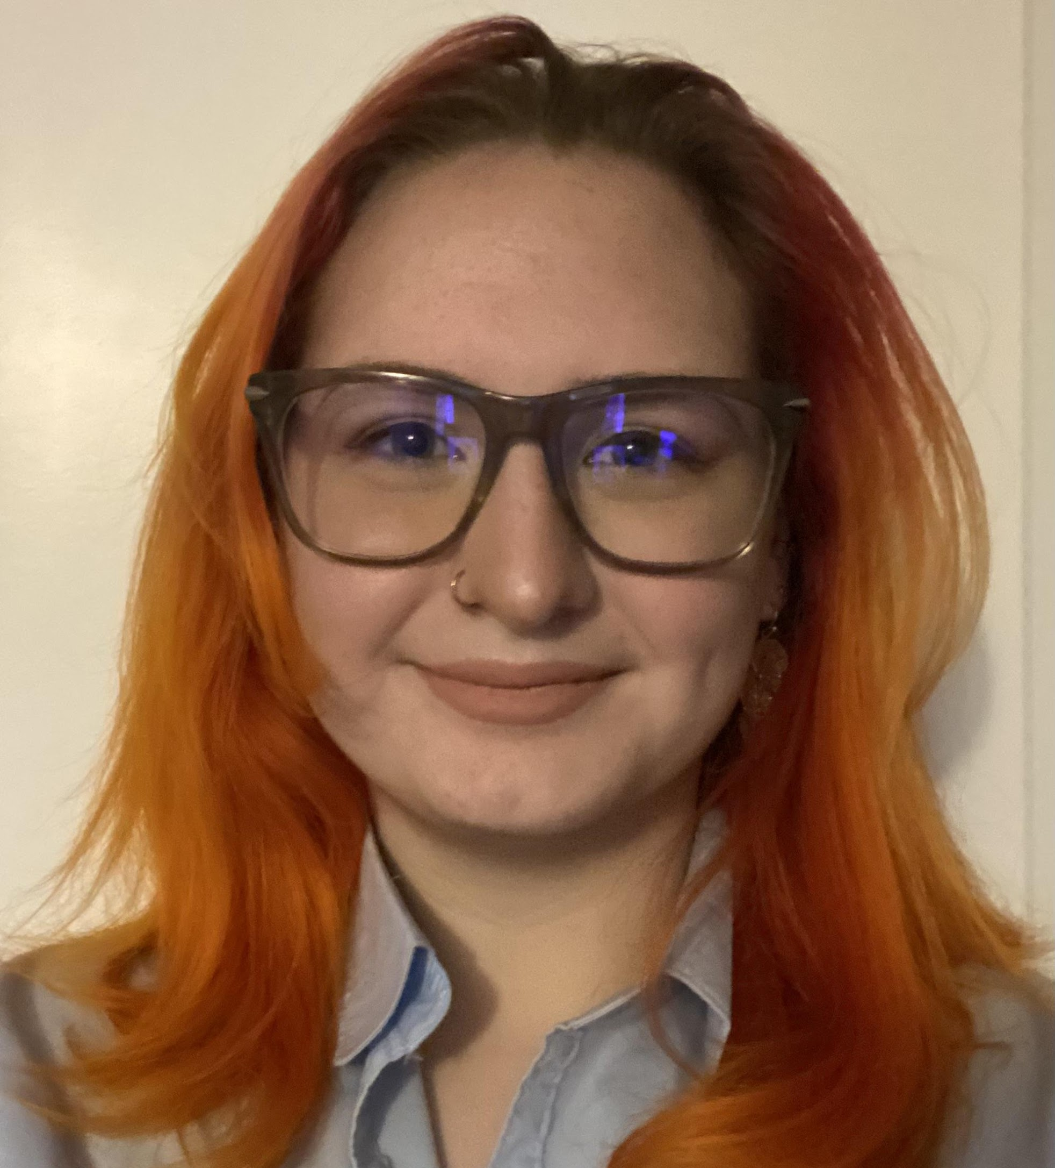
Bachelor of Science in Mathematics
Samantha Alexis Mink
Cum Laude

Slide 45
Bachelor of Science in Mathematics
Erik Ostenfeld

Slide 46
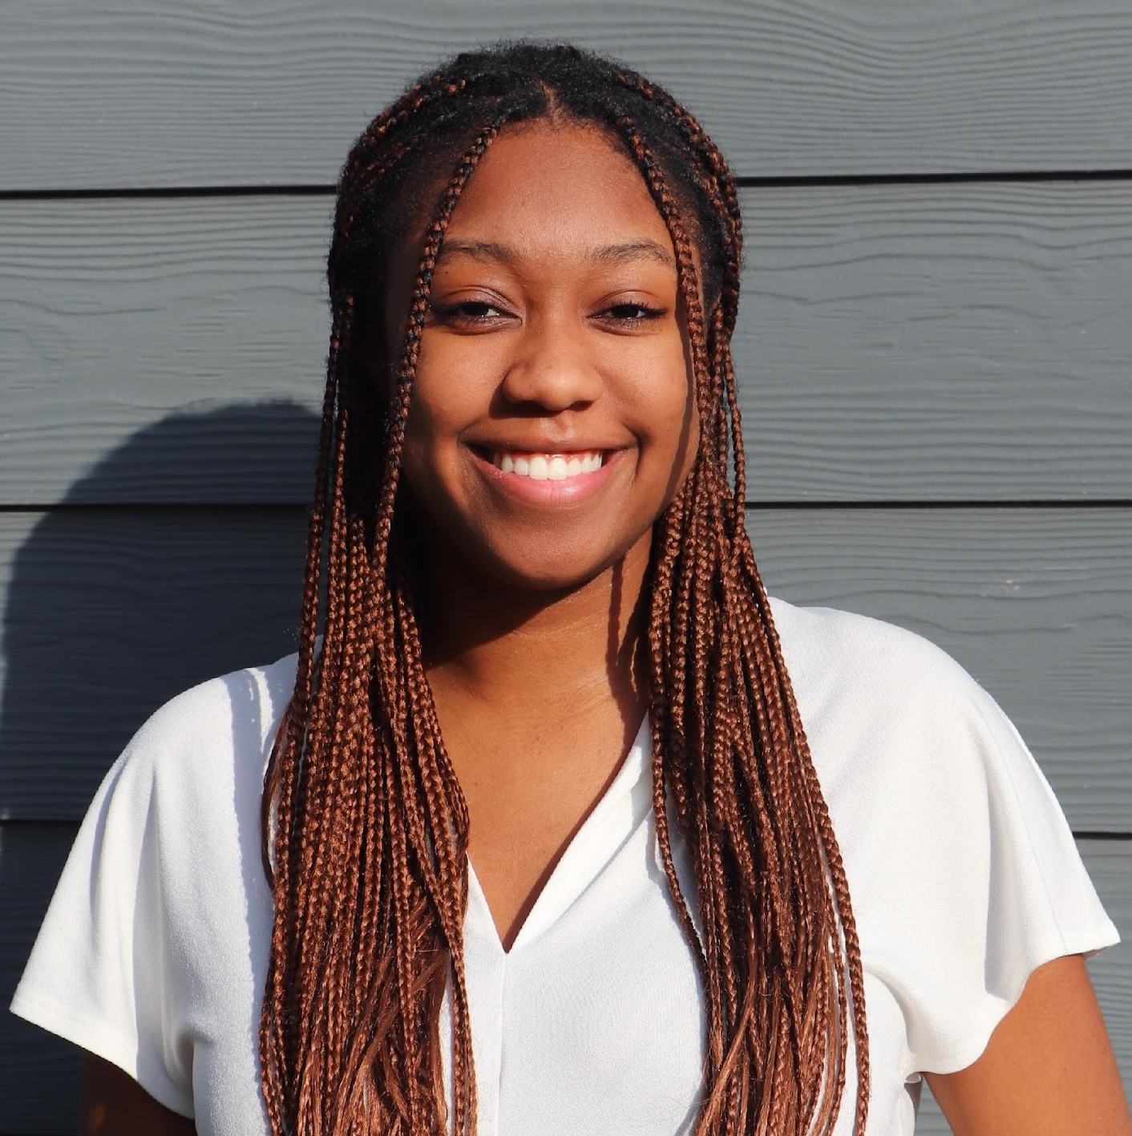
Bachelor of Science in Mathematics
Sheri Rouse
Cum Laude

Slide 47
Bachelor of Science in Mathematics
John Skeen
Magna Cum Laude

Slide 48
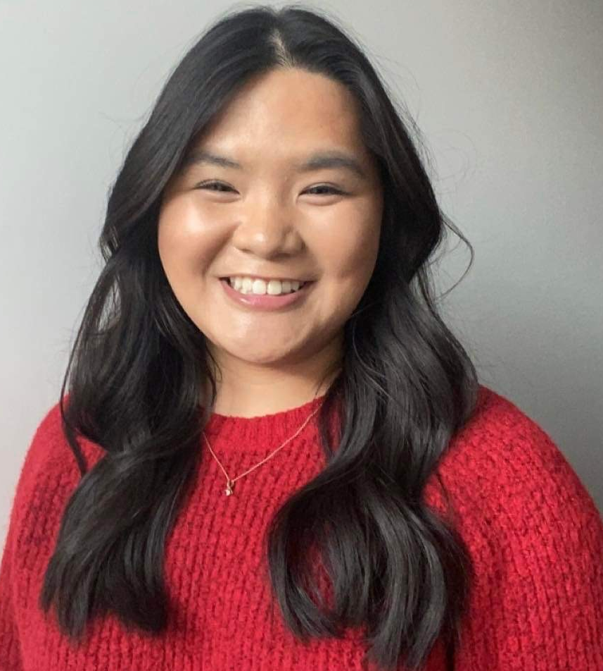
Bachelor of Science in Mathematics
Dominique Tan

Slide 49
Bachelor of Science in Mathematics
Nicholas Tibbels
Magna Cum Laude

Slide 50
Bachelor of Science in Mathematics
Madelyn Tyrrell
Magna Cum Laude

Slide 51
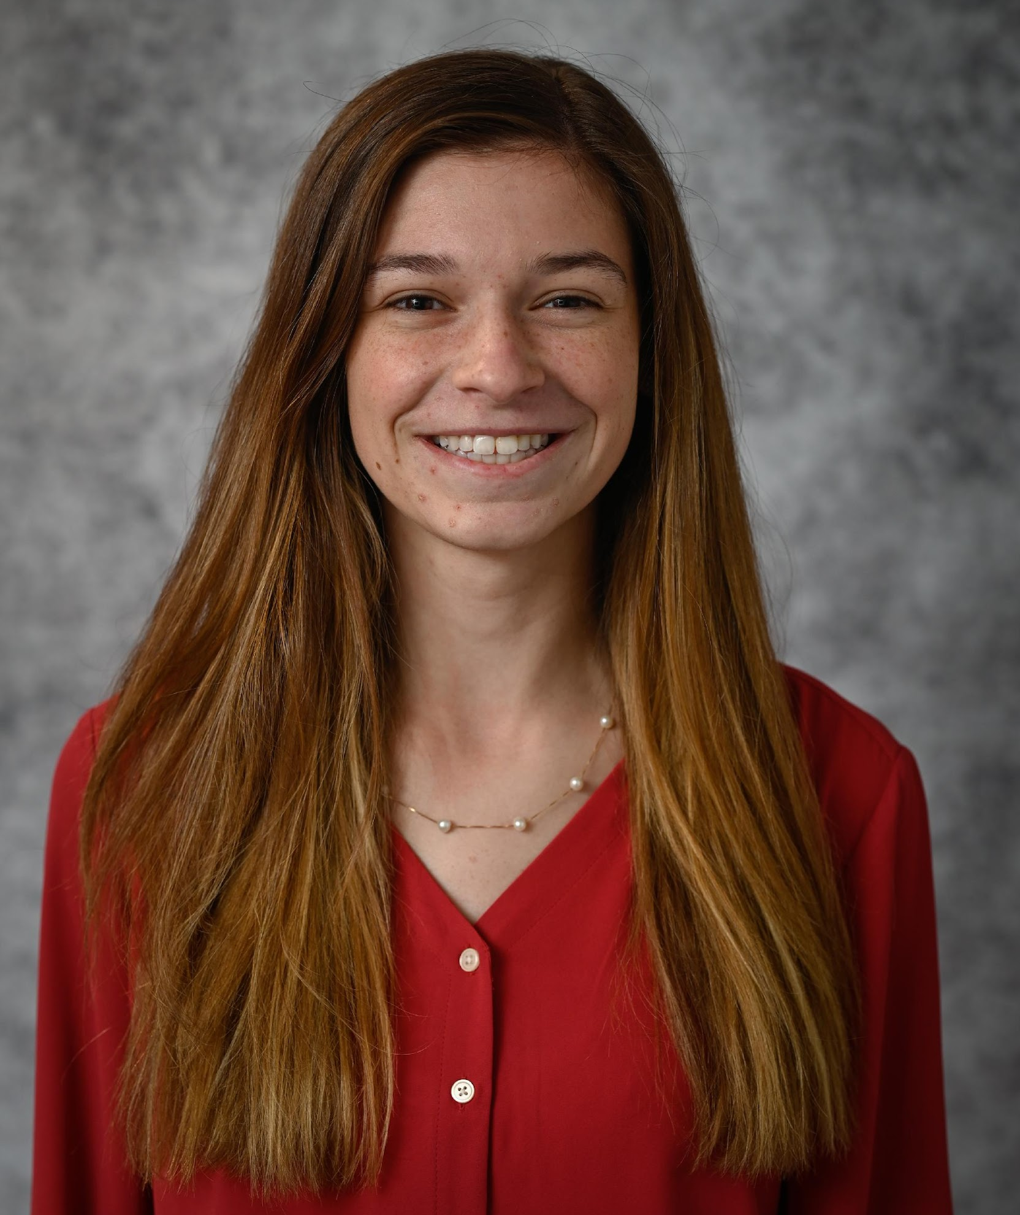
Bachelor of Science in Mathematics
Jenna Varnell
Summa Cum Laude

Slide 52
Bachelor of Science in Mathematics
Galen Wilcox
Summa Cum Laude

Slide 53
Bachelor of Science in Mathematics
Bocheng Zhu

Slide 54
Mathematics Department Graduate Degrees
Class of 2023

Slide 55
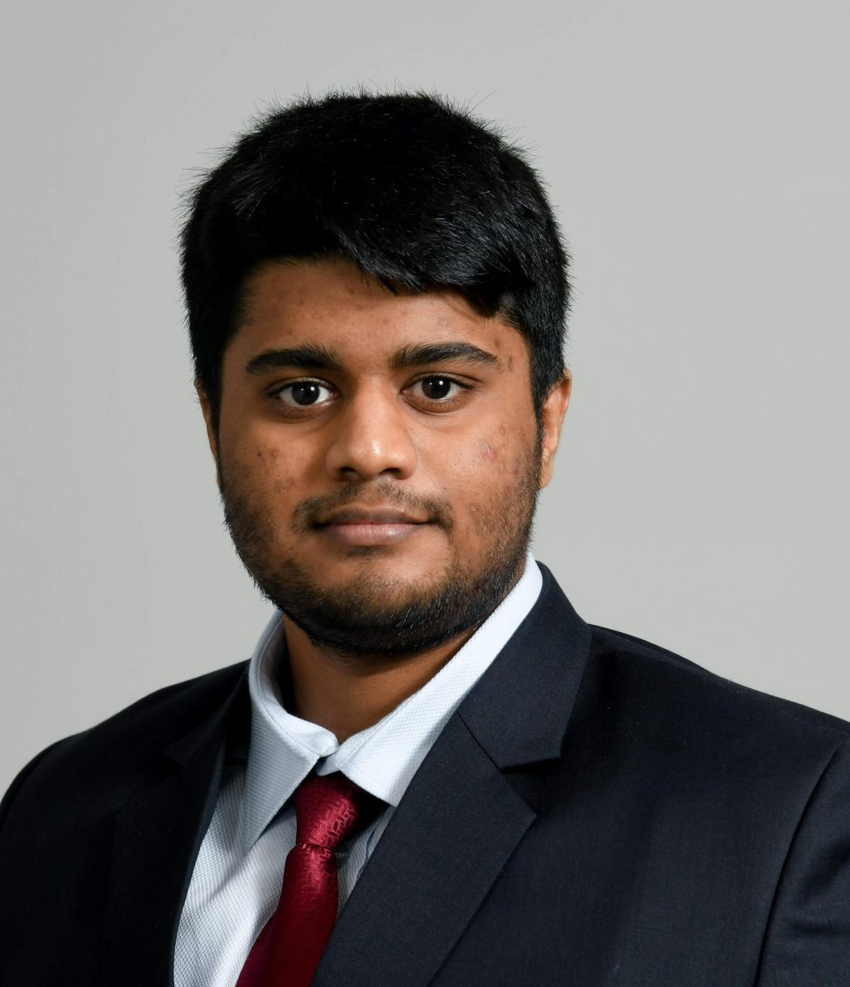
Master of Financial Mathematics
Param Arunachalam

Slide 56
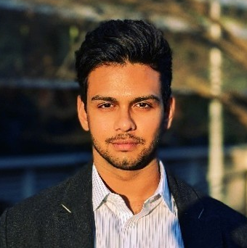
Master of Financial Mathematics
Sachin Iyengar

Slide 57
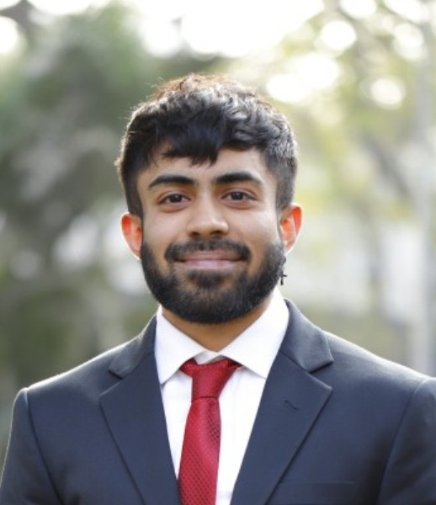
Master of Financial Mathematics
Ritobhash Ray

Slide 58
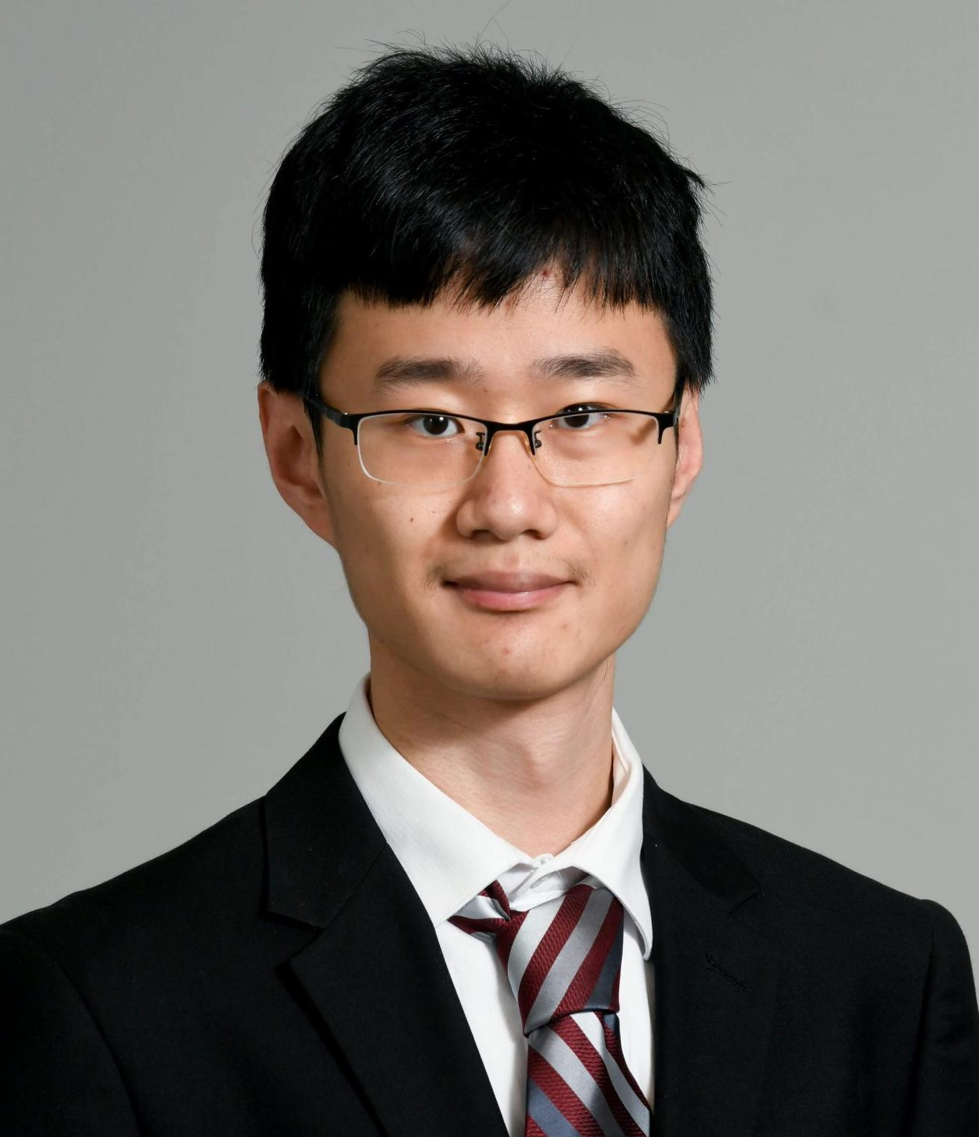
Master of Financial Mathematics
Zhikai (Kyle) Yan

Slide 59
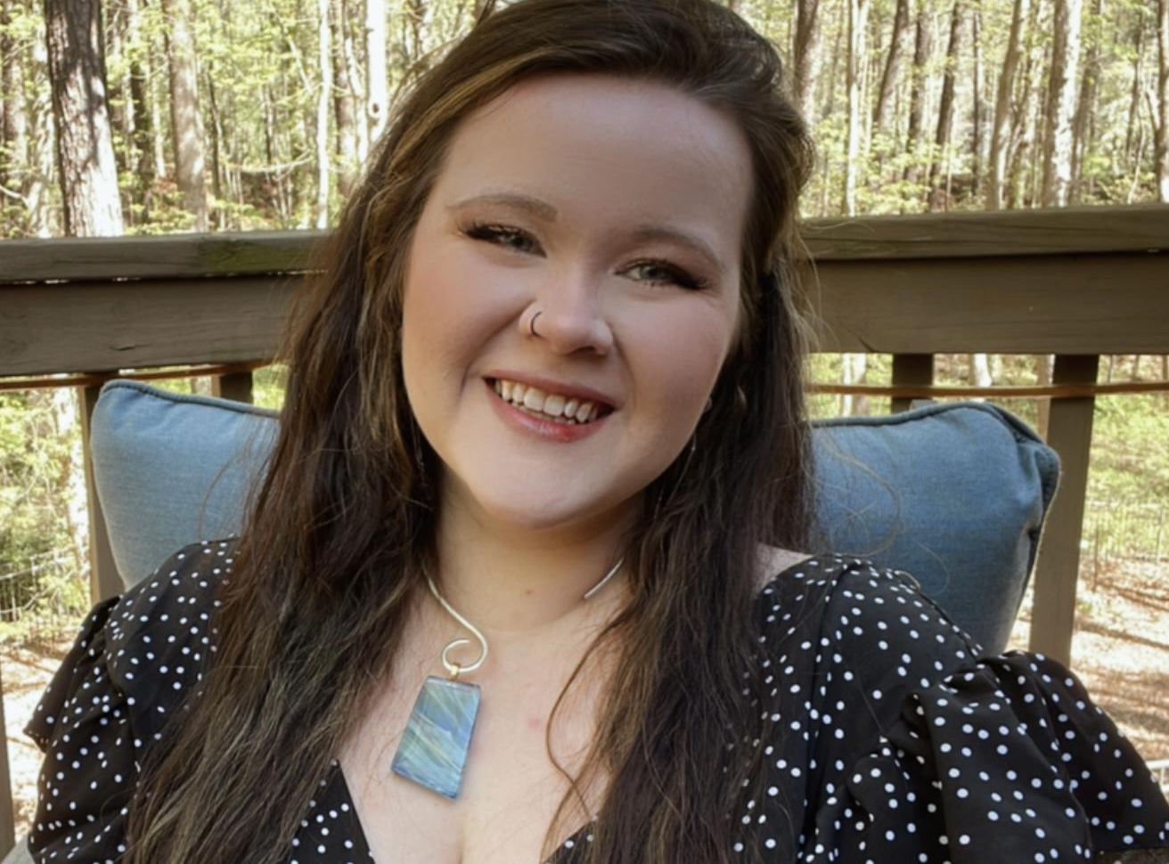
Master of Science in Applied Mathematics
Erin Leigh Bednarek

Slide 60
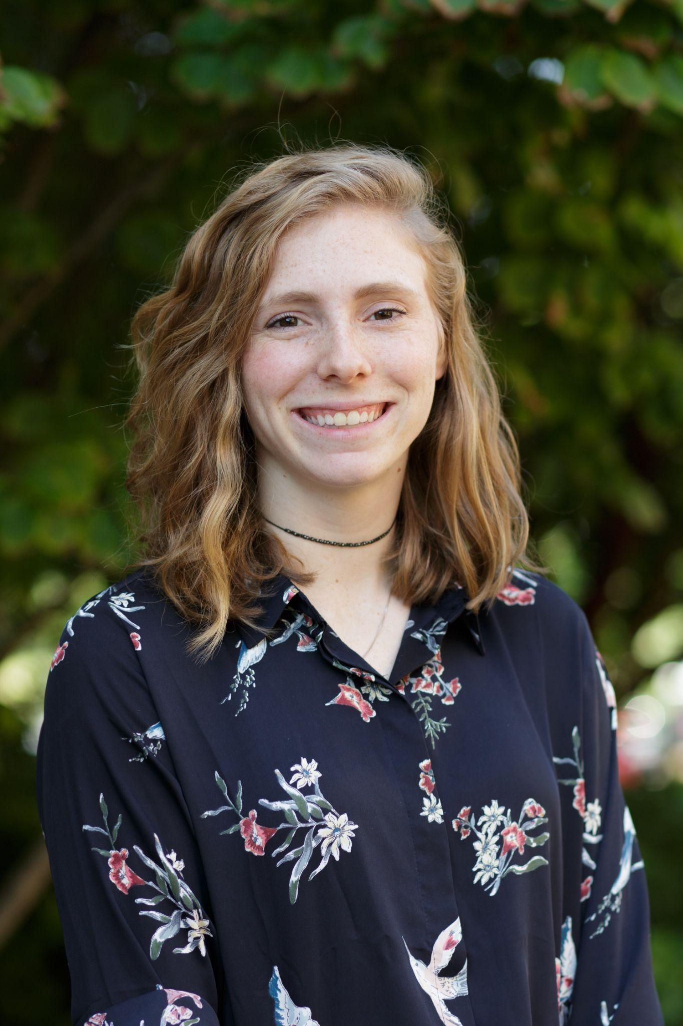
Master of Science in Applied Mathematics
Stephanie Brooke
Westaway Gilley

Slide 61
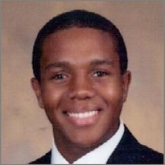
Master of Science in Applied Mathematics
Khalil Alexander Hall-Hooper

Slide 62
Master of Science in Applied Mathematics
Thy (Molena) Nguyen

Slide 63
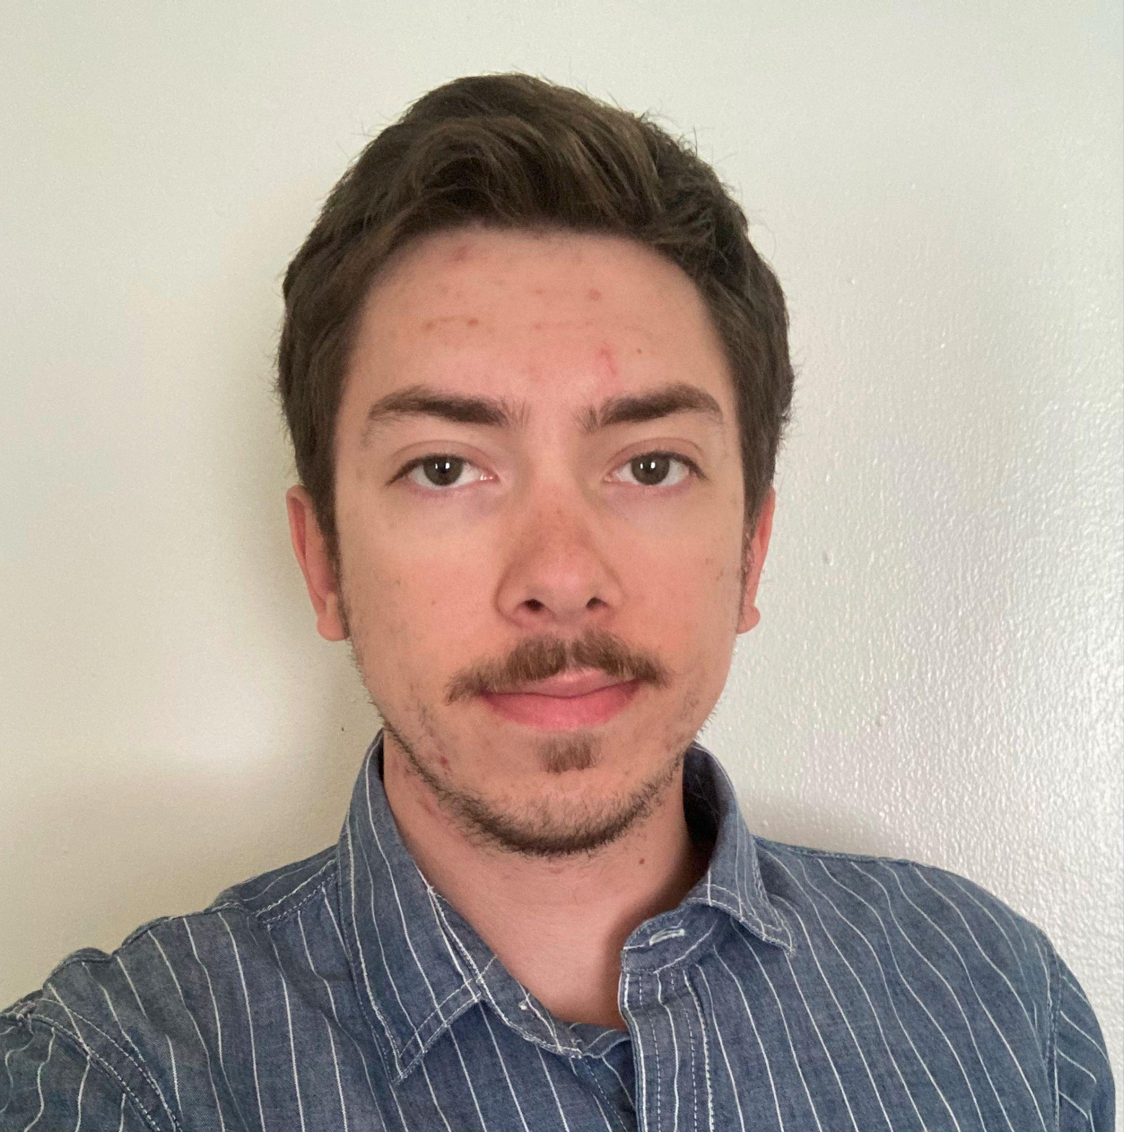
Master of Science in Applied Mathematics
John Nicholas Neuberger

Slide 64
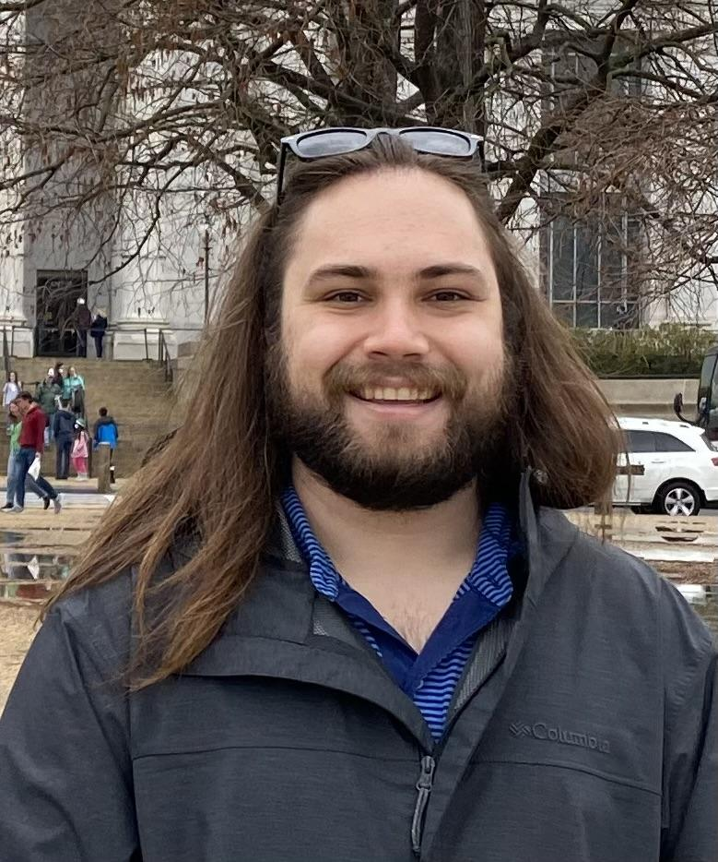
Master in Mathematics
Thomas Elgin

Slide 65
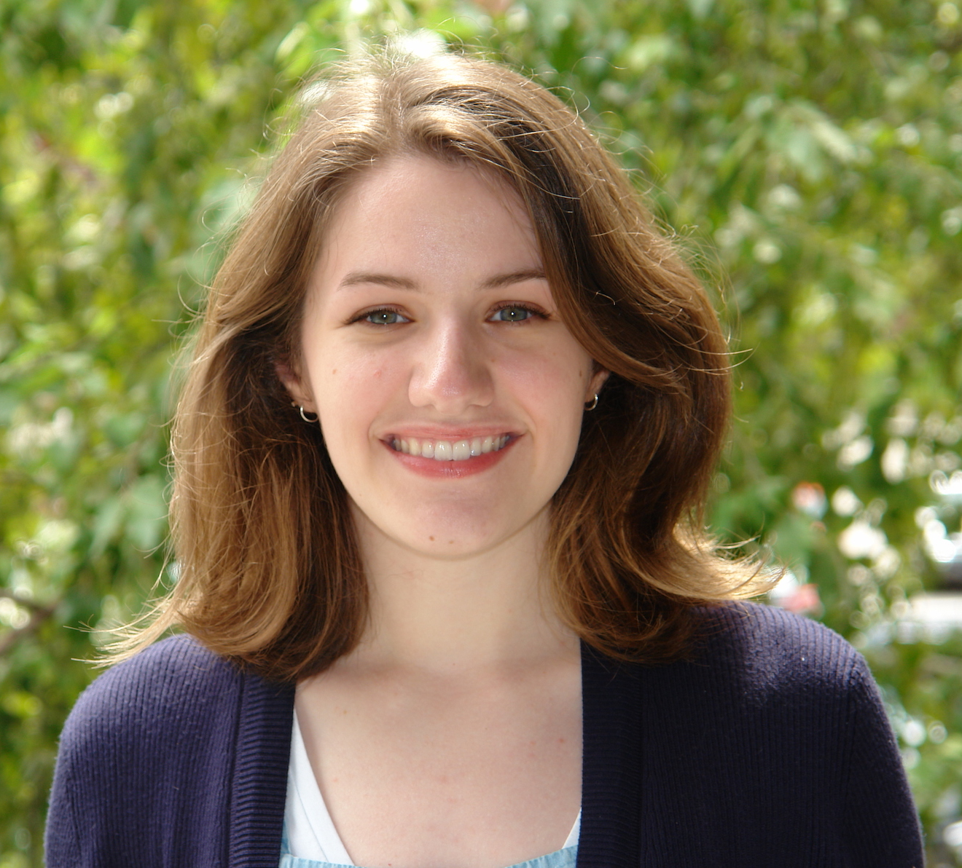
Master of Science in Mathematics
Delaney Howsden Martin

Slide 66
Master of Science in Mathematics
John Revelle

Slide 67
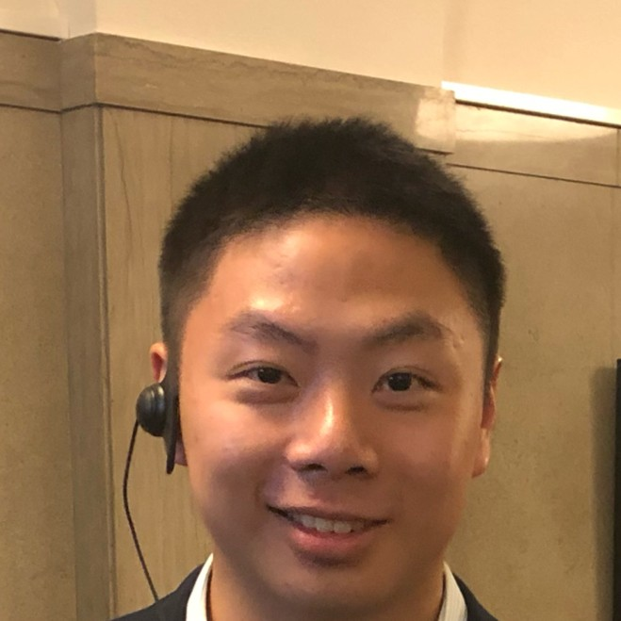
Master of Science in Mathematics
Tiancheng Xue

Slide 68
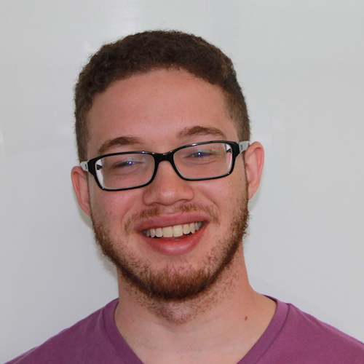
PhD in Applied Mathematics
William Michael Anderson

Slide 69
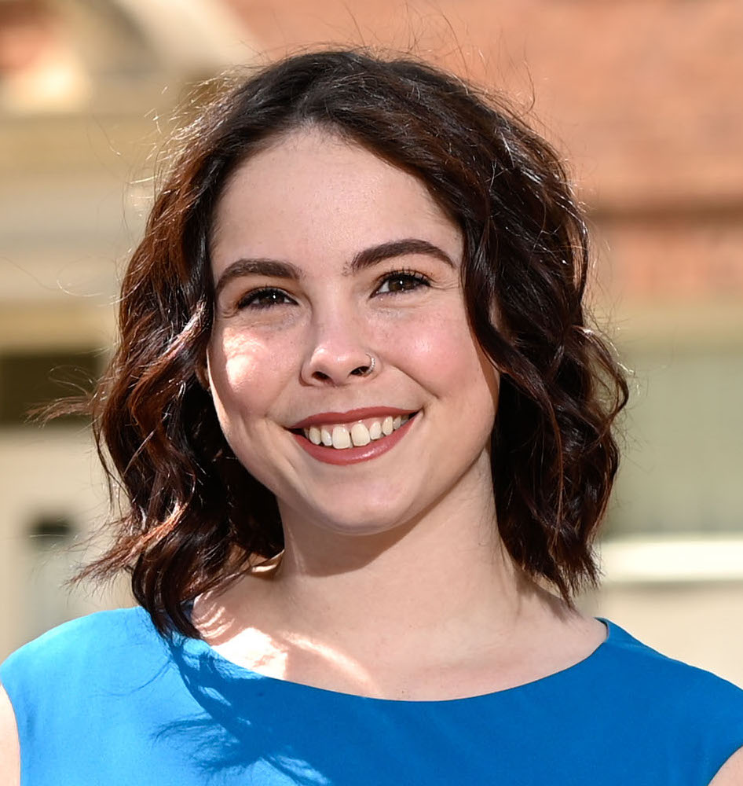
PhD in Applied Mathematics
Amanda Colunga

Slide 70
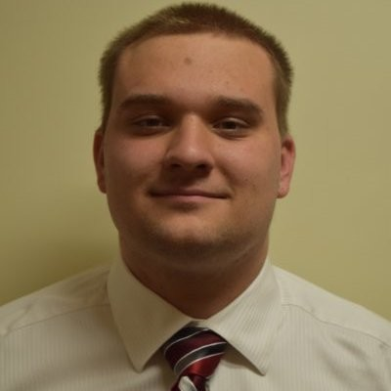
PhD in Applied Mathematics
Robin Morillo

Slide 71
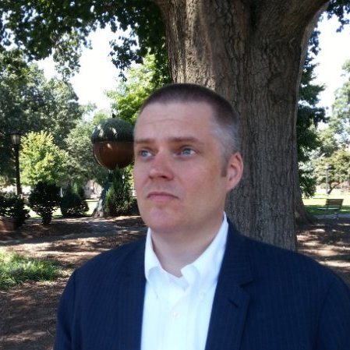
PhD in Applied Mathematics
James M. Stephens Jr.

Slide 72
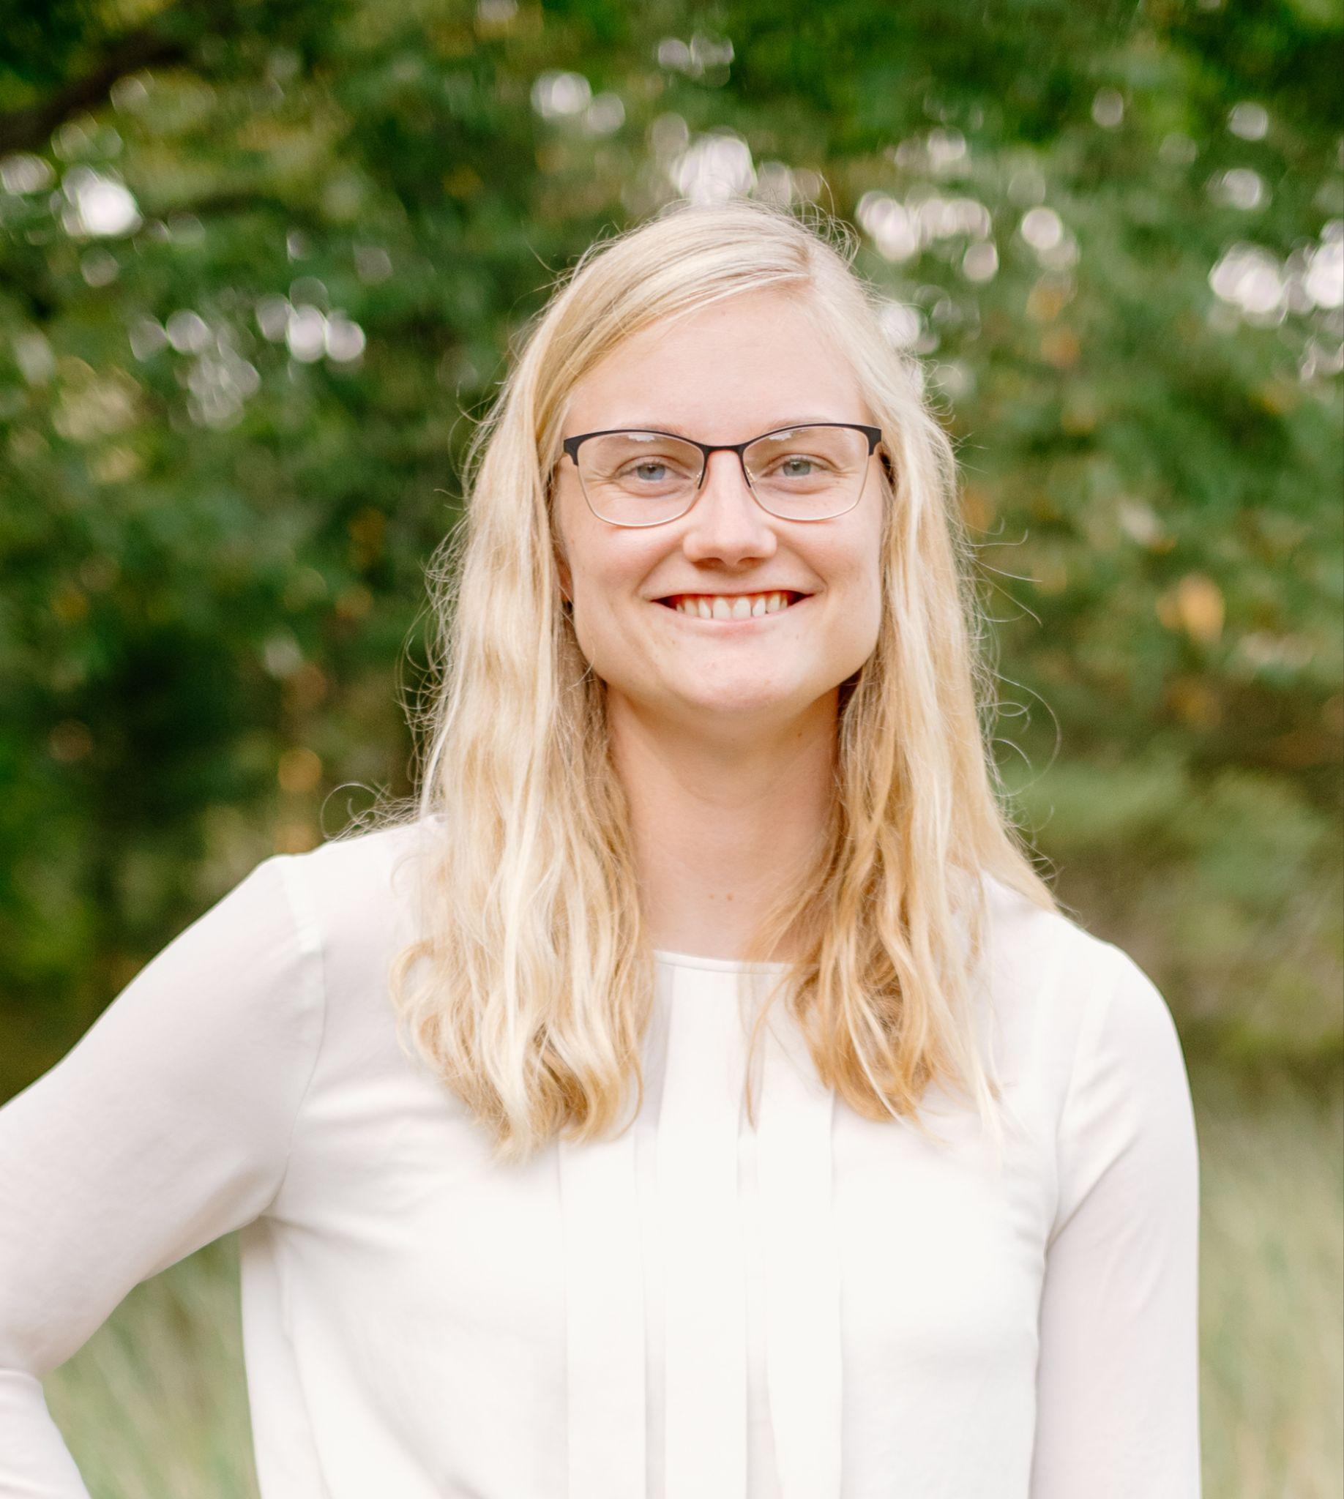
PhD in Applied Mathematics
Sarah Lynn Strikwerda

Slide 73
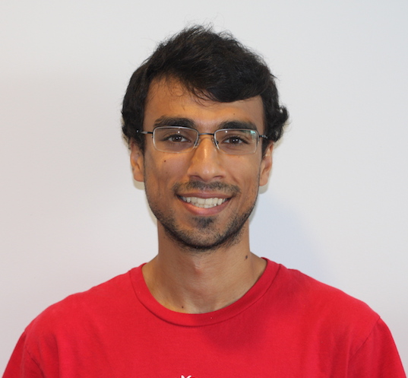
PhD in Mathematics
Jai Aslam

Slide 74
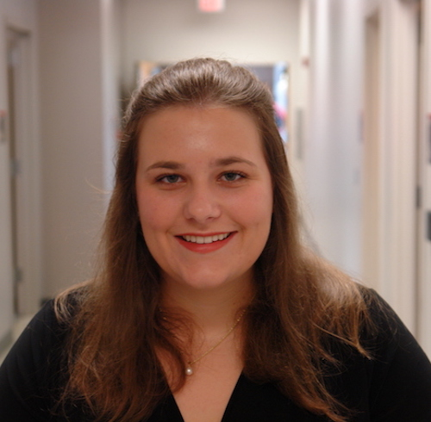
PhD in Mathematics
Emma Kathryn Groves

Slide 75
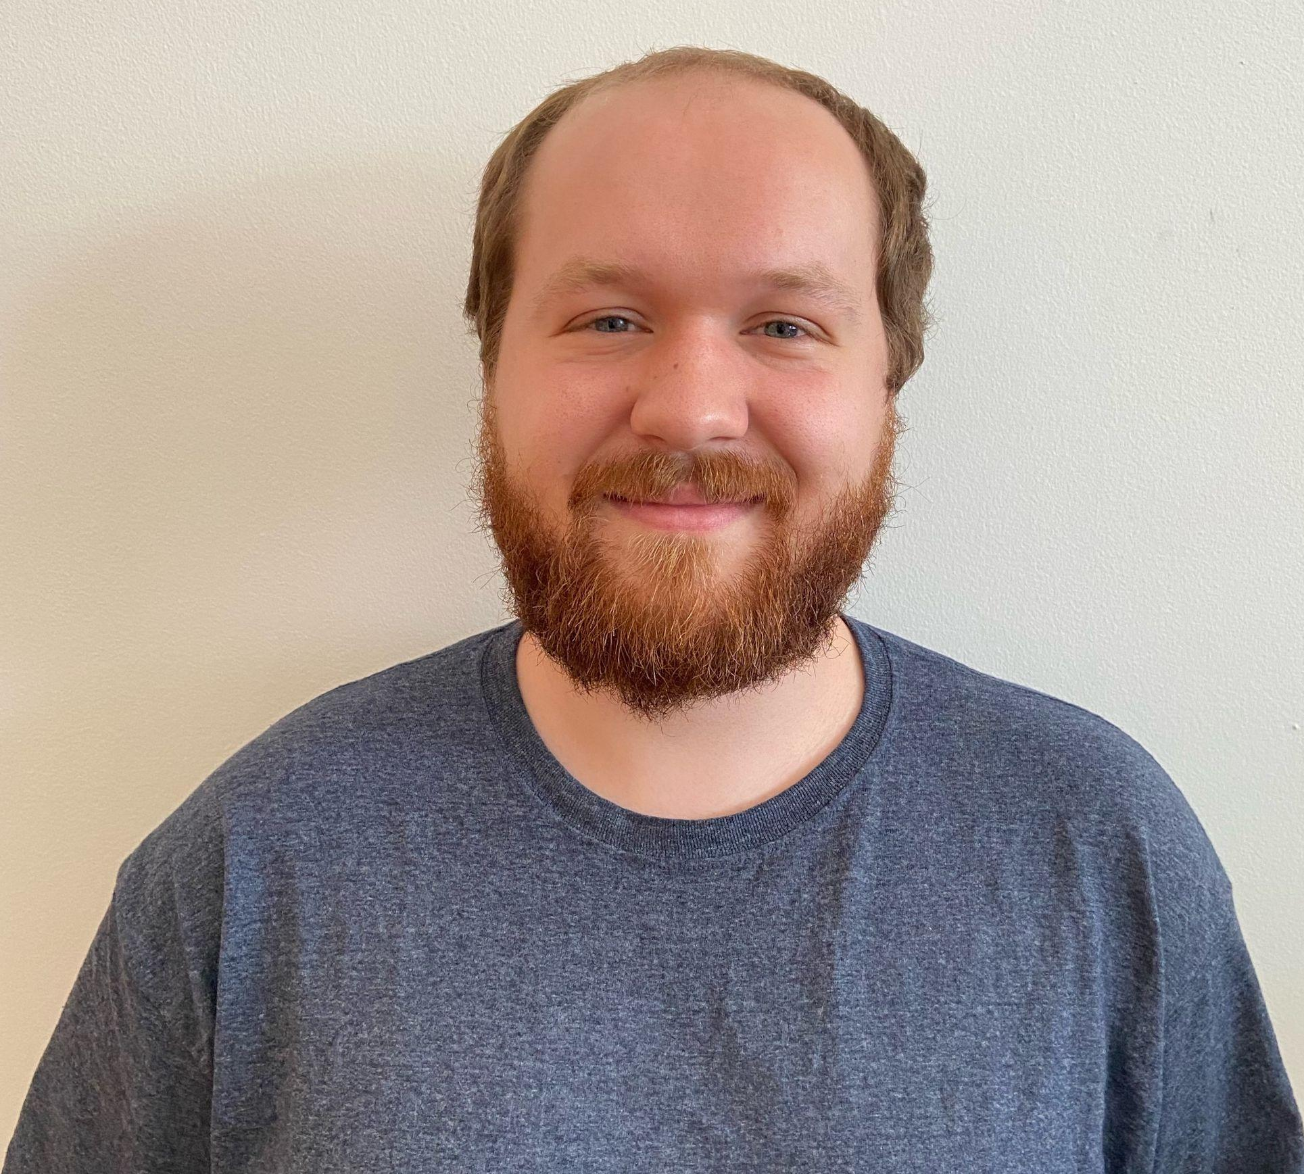
PhD in Mathematics
Joseph Johnson

Slide 76
PhD in Mathematics
David White

Slide 77
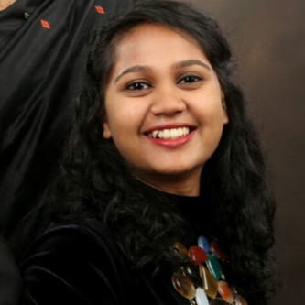
PhD in Biomathematics
Praachi Das

Slide 78
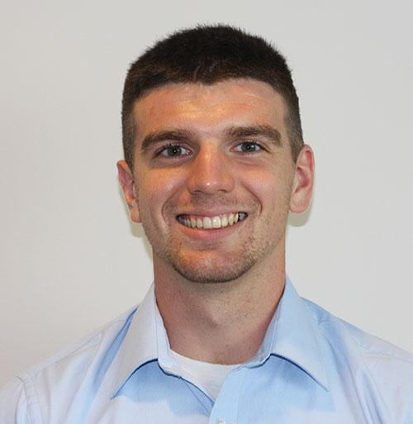
PhD in Biomathematics
Justen R. Geddes

Slide 79
PhD in Biomathematics
Sabina Rich

Slide 80
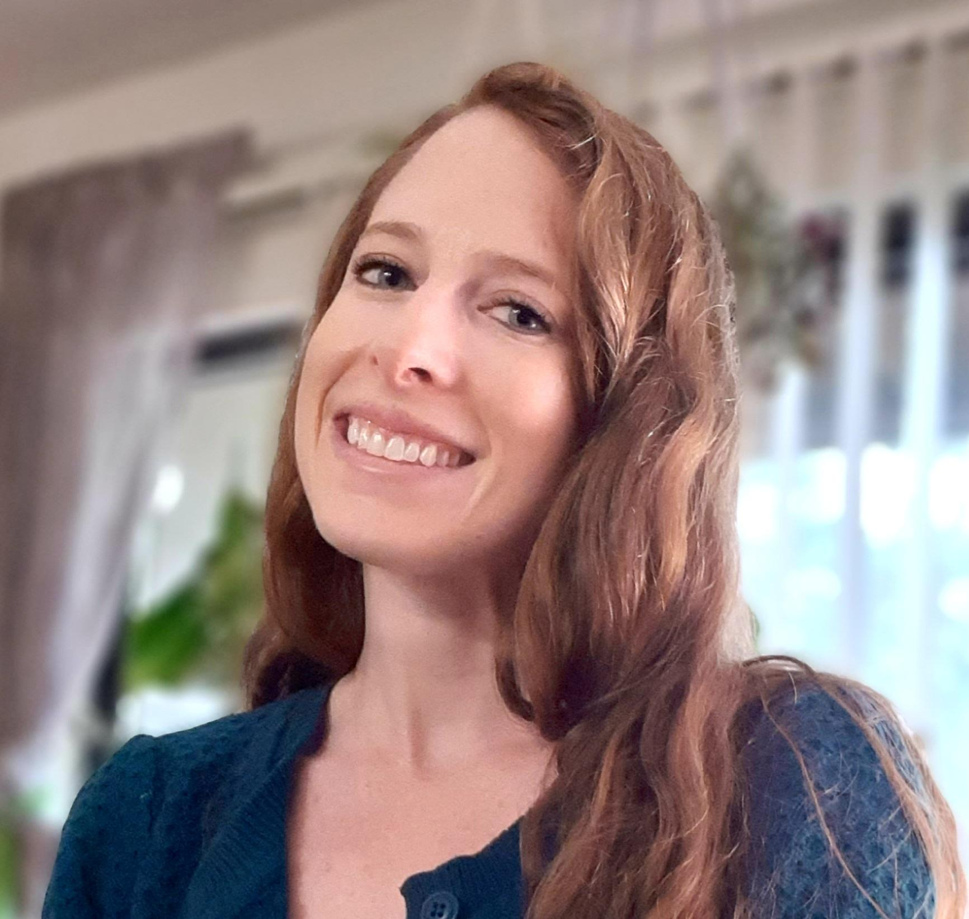
PhD in Biomathematics
Celia Schacht

